Slide 1
Welcome to Holy Hermits Online Worship
14th Sunday after Pentecost
Today, we are remembering
Holy Hermit St. Jerome of Stridon
Service Prep: Kris | Chat Host: Viki | First Reader: Liz*
Music: Wiggles | Welcomer: Julie | Second Reader: Kieron
Proof-reader: Lauren | Priest: N/A | Preacher: Lauren
Broadcaster: Lauren | Deacon: Lauren | Fellowship: Lauren
Backup Broadcaster: Barry | Leader: Jeremy | Safety Officer: Julie
Zoom Buttons: Viki | Cantor: Julie | Attendance: Viki
Notes:
Please try to keep all fonts size 28 with 1.5 spacing so that it is easier for people to read
Readers with an ‘*’ after their name in the roster are down to pre-record, please include ‘*’ in the slide

Slide 2






Hospitality
Leader:
Please mute for the service unless invited to offer your voice as part of the service ministry
Have the video camera on or off and turn the volume and brightness up or down on your device if things are too loud 🔉🔊or too bright🔅🔆
Our Cantor acts as our voice, offering the responses, in Bold Text, which we say together
Feel welcome to use the chat and reaction emojis 👍
🙏 Please take care of yourself in this space. 🙏 Come and go as you need
😴 It is great to take rest in this space, so falling asleep is also OK 😴
👂️ Remember, pastoral care is available to all in the community, if you'd like to speak to someone about anything spiritual. ❤️ Visit the help page at the website to reach out 🌐
Our Being Together ethos and safeguarding practices can also be accessed on the website 🫶​
🙌 Come as you are – we are all here together! 🙌
Notes:
Used Lent 2022

Slide 3
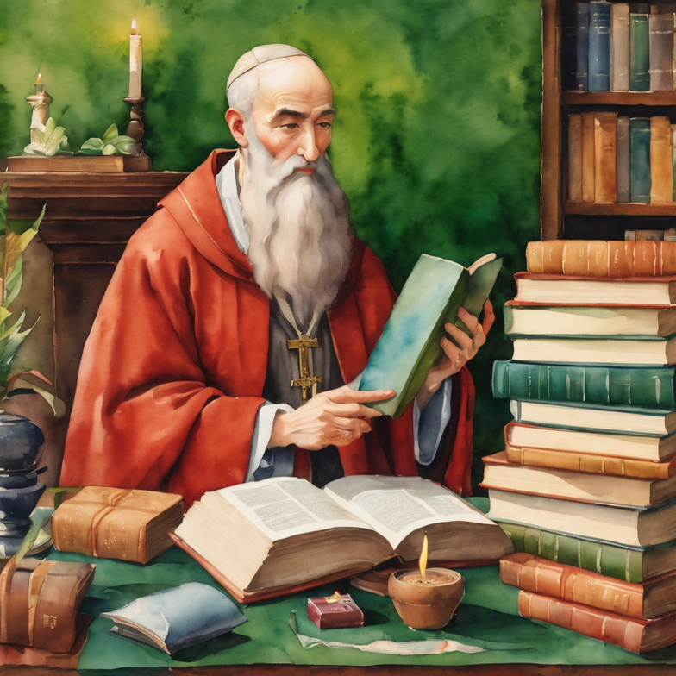
Leader: Our Holy Hermit today is St. Jerome of Stridon
Jerome is best known for his translation of the Bible from Hebrew and Old Latin.
He is particularly important for having made the core of the accepted Latin translation of the Bible known as the Vulgate.
He also wrote defending the virginity of Mary and engaged in debates on several other heresies of the time.
Notes:
Please Keep to approximately 100 word or less

Slide 4
He had an opinion on whether marriage and virginity should be viewed as equally righteous in Adversus Jovinianum, and defended monasticism and celibacy in Contra Vigilantium.
One of the people he corresponded with was St Augustine. St Augustine said of him, “What Jerome is ignorant of, no mortal has ever known.”
St Jerome is the patron saint of archaeologists, Biblical scholars, librarians, students and translators.
To read more about our hermits click the link​​ in the send out

Slide 5
Invitation
Leader: As we come into worship let’s take a few deep breaths,
Let go of anything that isn’t serving us,
And become aware of God’s presence here with us.
Opening Music: https://www.youtube.com/watch?v=1p23I6K6hgM

Slide 6
Leader and Cantor unmute
The Greeting
Leader:
The grace of the Lord Jesus Christ,
and the love of God,
and the fellowship of the Holy Spirit,
be with you all.
All: And also with you.

Slide 7
Gathering Prayer
Leader:
Come, let us worship the one who calls us,
guides us and encourages us.
Let us praise the one who knows and loves us.
Let us join our voices, our hearts and minds,
as we listen for God’s voice calling us,
coming to worship together as God’s church.
Notes:
Use Call to Worship Prayer https://www.rootsontheweb.com

Slide 8
Gathering Prayer
All:
Lord God,
thank you that you have called us here today:
to hear and receive your word to us;
to be inspired, challenged, motivated,
and supported in the steps we take.
Whatever the journey, long or short, easy or not,
we follow you in faith.
Amen.
Notes:
Use gathering prayer - Roots

Slide 9
Sentence
Leader: I invite our Cantor to proclaim the sentence for today.
Cantor:
If you want to become a disciple of Jesus, deny yourself, take up your cross and follow him.
Matthew 16.24-25
Notes:
From Epray – ensure the text is black and font size is 28

Slide 10
Prayer of Approach
Leader: We pray the prayer of approach together
All: Who are we to stand before the great I AM?
Yet, we are invited into his Kingly presence
to journey forward with God.
Come and enter into worship
and exalt our Glorious King.
Notes:
Prayer of Approach from Roots

Slide 11
Leader unmutes
Our first Hymn
Take Up Thy Cross
https://www.youtube.com/watch?v=t5xlxaesqQg
We stay on mute
Leader mutes

Slide 12
The Deacon or LA introduces the Confession​
God is steadfast in love and infinite in mercy, welcoming sinners and inviting them to the Lord's table.
Silence may be kept.​
Let us confess our sins in penitence and faith, with a sincere and a true heart.
Notes:
Epray – has seasonal variation

Slide 13
All: ​Merciful God, our maker and our judge, ​
we have sinned against you ​in thought, word, and deed, ​
and in what we have failed to do: ​
we have not loved you with our whole heart; ​
we have not loved our neighbours as ourselves; ​
we repent, and are sorry for all our sins.​
Father, forgive us. Strengthen us to love and obey you
in newness of life; ​through Jesus Christ our Lord. ​
Amen.​

Slide 14
Words of Assurance offered by the Deacon or LA
These words of assurance from the First Letter of John declare that:
If anyone sins, we have an advocate with the Father, Jesus Christ the righteous. He is the perfect offering for our sin, and not for ours only, but for the sins of the whole world.
(1 John 2: 1-2)
In this is love, not that we loved God, but that he loved us and sent his Son to be the perfect offering for our sins.
(1 John 4:10)

Slide 15
Collect
Leader: O God,
whose Son has shown the way of the cross to be the way of life:
transform and renew our minds
that we may not be conformed to this world
but may offer ourselves wholly to you as a living sacrifice
through Jesus Christ our Saviour;
who lives and reigns with you and the Holy Spirit,
one God, now and for ever.
Amen.
Notes:
From Epray – ensure the text is black and font size is 28

Slide 16

The 1st reader unmutes
Leader: We will now listen to the first reading
Reader 1: The 1st Reading is from Exodus 3.1-15
¹ Moses was keeping the flock of his father-in-law Jethro, the priest of Midian; he led his flock beyond the wilderness, and came to Horeb, the mountain of God. ² There the angel of the Lord appeared to him in a flame of fire out of a bush; he looked, and the bush was blazing, yet it was not consumed.
Continue…
Notes:
**Please note that the first reading is recorded this week YouTube link if needed: https://youtu.be/OksJo_sptLQ
If the 1st reading is recorded change the introduction to “Leader: We will now listen to the first reading”
(Normal introduction: “I invite the 1st reader to unmute and offer the 1st lesson when ready”)
** Note the Cantor still responds with “Thanks be to God” at the conclusion of the reading
From Epray – ensure the text is black and font size is 28

Slide 17
³ Then Moses said, ‘I must turn aside and look at this great sight and see why the bush is not burned up.’
⁴ When the Lord saw that he had turned aside to see, God called to him out of the bush, ‘Moses, Moses!’ And he said, ‘Here I am.’
⁵ Then he said, ‘Come no closer! Remove the sandals from your feet, for the place on which you are standing is holy ground.’
⁶ He said further, ‘I am the God of your father, the God of Abraham, the God of Isaac, and the God of Jacob.’ And Moses hid his face, for he was afraid to look at God.
Continue…

Slide 18
⁷ Then the Lord said, ‘I have observed the misery of my people who are in Egypt; I have heard their cry on account of their taskmasters. Indeed, I know their sufferings, ⁸ and I have come down to deliver them from the Egyptians, and to bring them up out of that land to a good and broad land, a land flowing with milk and honey, to the country of the Canaanites, the Hittites, the Amorites, the Perizzites, the Hivites, and the Jebusites. ⁹ The cry of the Israelites has now come to me; I have also seen how the Egyptians oppress them.
Continue…

Slide 19
¹⁰ So come, I will send you to Pharaoh to bring my people, the Israelites, out of Egypt.’ ¹¹ But Moses said to God, ‘Who am I that I should go to Pharaoh, and bring the Israelites out of Egypt?’
¹² He said, ‘I will be with you; and this shall be the sign for you that it is I who sent you: when you have brought the people out of Egypt, you shall worship God on this mountain.’ ¹³ But Moses said to God, ‘If I come to the Israelites and say to them, “The God of your ancestors has sent me to you”, and they ask me, “What is his name?” what shall I say to them?’
Continue…

Slide 20
¹⁴ God said to Moses, ‘I am who I am .’ He said further, ‘Thus you shall say to the Israelites, “I am has sent me to you.” ’
¹⁵ God also said to Moses, ‘Thus you shall say to the Israelites, “The Lord , the God of your ancestors, the God of Abraham, the God of Isaac, and the God of Jacob, has sent me to you”: This is my name for ever, and this my title for all generations.
For the word of the Lord. Thanks be to God.​

Slide 21
The Leader will lead the Psalm
Leader: We now say the psalm antiphonally, we will all respond with our cantor as our voice.
Psalm 105
1-6,
23-26
¹ O give thanks to the Lord and call upon his name:
tell among the peoples what things he has done.
² Sing to him, O sing praises:
and be telling of all his marvellous works.
³ Exult in his holy name:
and let those that seek the Lord be joyful in heart.
Continue…
Notes:
From Epray – ensure the text is black and font size is 28
If the 1st reading is recorded please:
add The Leader will lead the Psalm to the top left of the screen
change the introduction to the Psalm to “Leader: We now say the psalm antiphonally, we will all respond with our cantor as our voice.”
- Normal introduction: “We now say the psalm antiphonally, I invite the first reader to lead, and we will all respond with our cantor as our voice.”

Slide 22
⁴ Seek the Lord and his strength:
O seek his face continually.
⁵ Call to mind what wonders he has done:
his marvellous acts, and the judgements of his mouth,
⁶ O seed of Abraham his servant:
O children of Jacob his chosen one.
²³ Then Israel came into Egypt:
and Jacob dwelt in the land of Ham.
Continue…

Slide 23
²⁴ There the Lord made his people fruitful:
too numerous for their enemies,
²⁵ Whose hearts he turned to hate his people:
and to deal deceitfully with his servants.
²⁶ Then he sent Moses his servant:
And Aaron whom he had chosen.

Slide 24
The 2nd reader unmutes
Leader: I invite the 2nd reader to unmute and offer the 2nd lesson when ready.
Reader 2: The 2nd Reading is from Romans 12.9-21
⁹ Let love be genuine; hate what is evil, hold fast to what is good; ¹⁰ love one another with mutual affection; outdo one another in showing honour. ¹¹ Do not lag in zeal, be ardent in spirit, serve the Lord. ¹² Rejoice in hope, be patient in suffering, persevere in prayer. ¹³ Contribute to the needs of the saints; extend hospitality to strangers.
Continue…
Notes:
From Epray – ensure the text is black and font size is 28

Slide 25
¹⁴ Bless those who persecute you; bless and do not curse them. ¹⁵ Rejoice with those who rejoice, weep with those who weep. ¹⁶ Live in harmony with one another; do not be haughty, but associate with the lowly; do not claim to be wiser than you are. ¹⁷ Do not repay anyone evil for evil, but take thought for what is noble in the sight of all. ¹⁸ If it is possible, so far as it depends on you, live peaceably with all.
Continue…

Slide 26
¹⁹ Beloved, never avenge yourselves, but leave room for the wrath of God; for it is written, ‘Vengeance is mine, I will repay, says the Lord.’ ²⁰ No, ‘if your enemies are hungry, feed them; if they are thirsty, give them something to drink; for by doing this you will heap burning coals on their heads.’ ²¹ Do not be overcome by evil, but overcome evil with good.
For the word of the Lord. Thanks be to God.​

Slide 27

We pause before
​the Gospel ​​

Slide 28
Deacon: The Gospel of our Lord Jesus Christ according to St Matthew Chapter 16 beginning at the 21stverse.
All: Glory to you Lord Jesus Christ.
²¹ From that time on, Jesus began to show his disciples that he must go to Jerusalem and undergo great suffering at the hands of the elders and chief priests and scribes, and be killed, and on the third day be raised. ²² And Peter took him aside and began to rebuke him, saying, ‘God forbid it, Lord! This must never happen to you.’
Continue…
Notes:
From Epray – ensure the text is black and font size is 28
Please note that there is a different introduction and final response if this is lay led

Slide 29
²³ But he turned and said to Peter, ‘Get behind me, Satan! You are a stumbling-block to me; for you are setting your mind not on divine things but on human things.’ ²⁴ Then Jesus told his disciples, ‘If any want to become my followers, let them deny themselves and take up their cross and follow me. ²⁵ For those who want to save their life will lose it, and those who lose their life for my sake will find it. ²⁶ For what will it profit them if they gain the whole world but forfeit their life? Or what will they give in return for their life?
Continue…

Slide 30
²⁷ ‘For the Son of Man is to come with his angels in the glory of his Father, and then he will repay everyone for what has been done. ²⁸ Truly I tell you, there are some standing here who will not taste death before they see the Son of Man coming in his kingdom.’
This is the Gospel of the Lord. Praise to you Lord Jesus Christ.

Slide 31
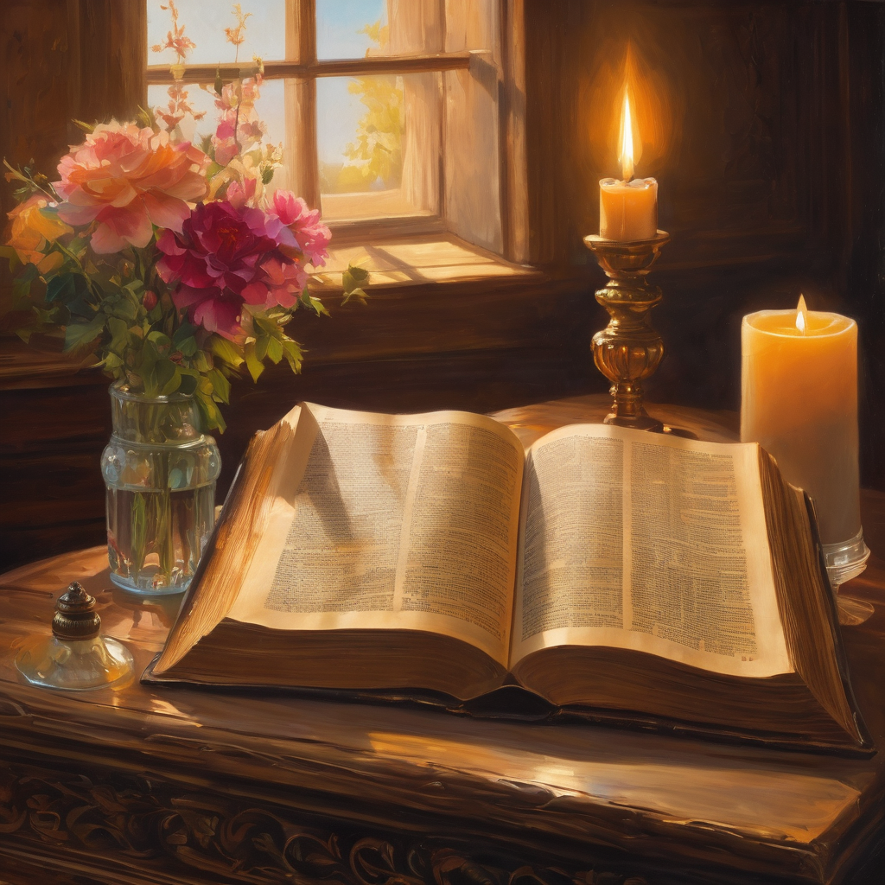
We pause
after ​the Gospel ​​

Slide 32
Leader: The Sermon is recorded to YouTube for sharing later.
Only the preacher's video and audio will be recorded.
The chat and other participants' feeds remain out of sight of the recording.
Leader and Cantor mute
Broadcaster exits screenshare
Preacher unmutes
Zoom buttons ”pins” preacher’s screen + selects “record to the cloud”
Sermon

Slide 33
Leader unmutes
Our next Hymn
Holy Ground
https://www.youtube.com/watch?v=HisFMCEbHzY
We stay on mute
Leader mutes

Slide 34
The Leader and Cantor unmute
The Greeting of Peace
Leader: We are the body of Christ
All: God’s Spirit is with us
Leader: The peace of the Lord be always with you.
All: And also with you.
Leader: A sign of peace may be exchanged
You may like to type 'Peace' into the chat, use the 'raise hand’ or other reaction buttons, or just simply wave via the screen with your video turned on
(Broadcaster exits shared screen for a few moments for the exchange of peace)

Slide 35
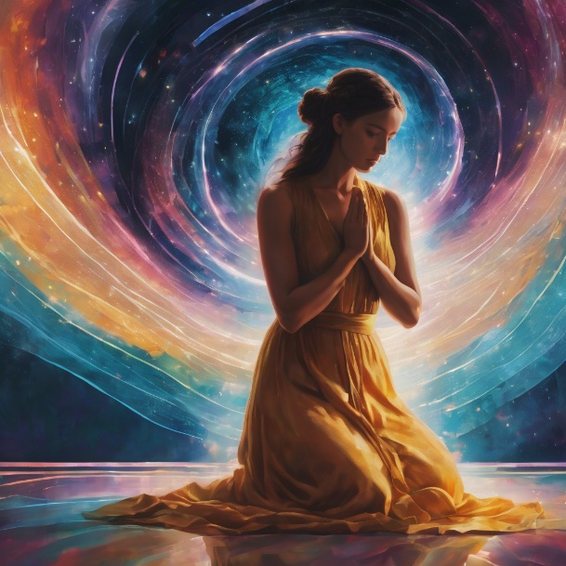
Prayer of Thanksgiving before Intercessions
Leader: As we enter prayer, I invite the second reader to unmute to lead our intercessions following the prayer of thanksgiving on the next slide. Please feel free to change your body position as you need.
Continue…

Slide 36
Leader: We give thanks to you, Great I AM.
Father, Son, and Holy Spirit, we give you praise.
Father, we thank you for your compassion,
and for those who have gone before us in faith.
Jesus, you came to show us the way, leaving footprints to follow.
Thank you for never giving up when we stumble,
for hearing us when we call, and for your loving care.
Holy Spirit, be our strength and courage, and help us trust your leading step by step.
Father, Son, and Holy Spirit, we give you praise. Amen.
Notes:
Prayer of praise and thanksgiving from Roots (if it’s too long still add it and it will be sorted out ☺)

Slide 37
Intercessions
Reader 2: We pray for creation and communities we share our lives with. We pause for a few moments to name either in our hearts, or out loud, or in the chat, those environments and communities we bring to the Lord in prayer.
PAUSE…
Continue…

Slide 38
Intercessions
Reader 2: We entrust to you the community of Holy Hermits Online and our ministry partners:
Prosper the work of our hands and show us the way to your new creation.
Creator God, Hear our prayer.
St John's Cathedral Brisbane The Anglican Diocese of Southern Queensland St Gabriel’s, Carindale Benedictus Contemplative Church, Canberra Anglican Focus and Tithe.ly

Slide 39
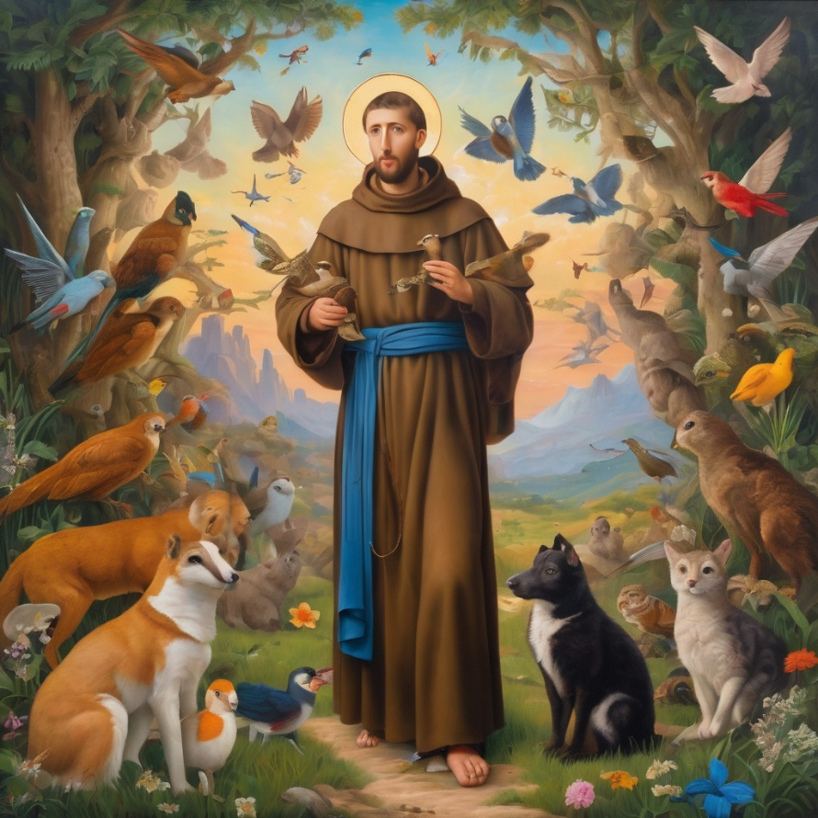
Reader 2: Loving Creator, we entrust to you all animals, especially those who are sick, anxious, ageing, lost, at risk, lonely, sad, hungry, in pain, homeless, abused, living in fear, encountering violence of any kind, in need of comfort, rehabilitation or transformation.

Slide 40
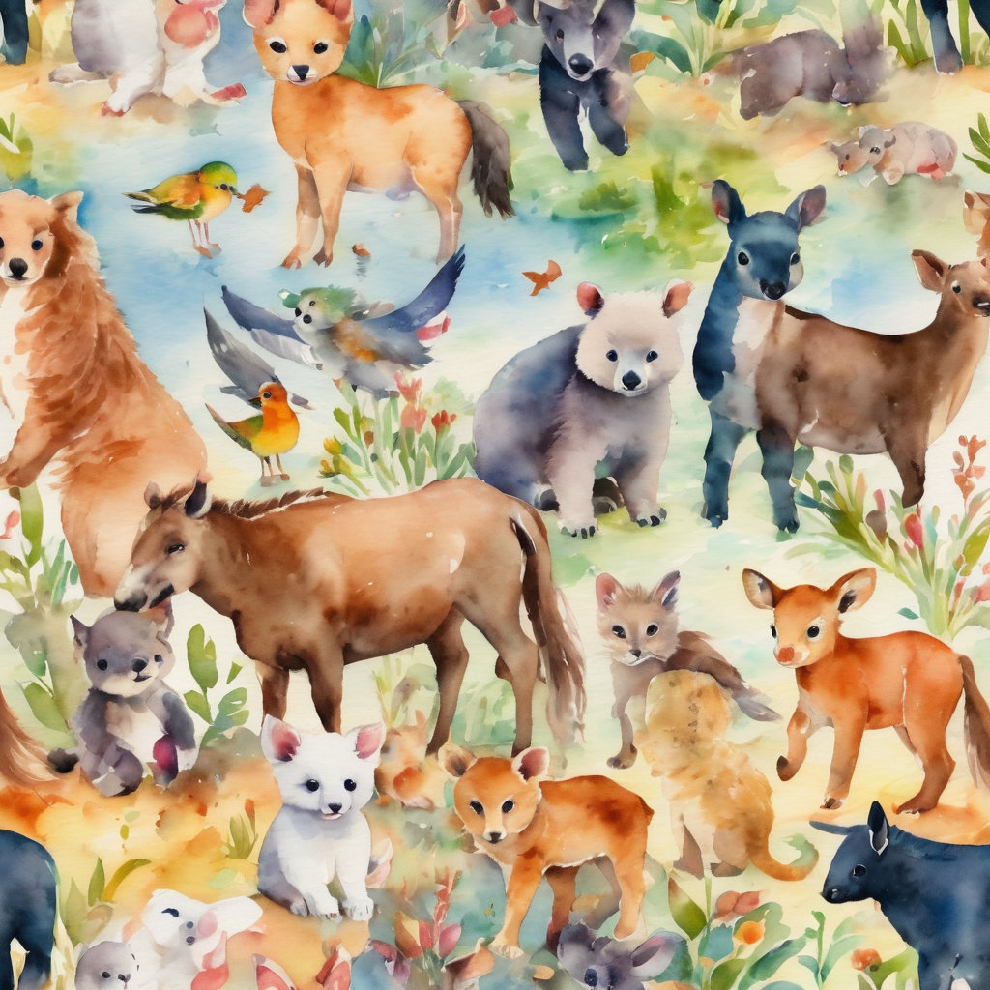
Reader 2: We invite your loving compassion for:
We name in our hearts, out loud or in the chat,
the animals we bring to the Lord in prayer. PAUSE…
Jasmine, ​
Leese(y), ​
Sid, Toots & Lulu​
Polly and Suki​
Fred, George & Percy​
Koshka ​
Jax
Lambert ​​
Kala, Nigel & Little One ​​
Toby​​
Taco​​
Paddy ​​
Rosie​
Squealer

Slide 41
Reader 2: Eternal Trinity of Love, we uphold to you the people we love and carry cares for:
Kerry, Les & Jake Julie, Ray, Tracey & Shane Mark, Desley & Bob ​​ Rachel, Mervyn & Gillian ​​Rev'd Shane & Janette​​ Alecia, Martin & Aidan​​ Kirsten, Greg, Daphne & Beau Bill & Marjorie​​ Aaron & Andrea Liz’s Godchildren Matthew & Nicholas | Barry​​ Dr Julie ​​ Ruth​​ Phil​ May Susan Tanya​ Neva Kathy ​Gayanne Tina | ​​ | Alan & Gaylene​ Jess & Leah ​​ Barry & Gwen Bob & Di​ Pat & Julie Dilys & Tony, Paul & Darhon Judy & Mary Miriam Lorelei Nettie

Slide 42
Reader 2:
We name in our hearts, out loud or in the chat, those we bring to the Lord in prayer.
PAUSE…
We entrust to you those who have died, those who have died peacefully and those who have died tragically, the old and the young. Receive them into your Kingdom. Lord in your mercy, Hear our prayers. Amen.

Slide 43
Pray Daily Cycle of Prayer
Leader: Loving God, joining with the Church in our cycle of prayer, we ask your blessings on:
The Church in the Province of the West Indies
The Parish of Buderim: Lucy, Lynette, John, Montague, Theo, Ann
Anglicare SQ & Indooroopilly Parish: Thread Together
Notes:
anglicanfocus.org.au/category/front-page/spirituality/pray-daily/

Slide 44
Commitment Prayer of the Week
Leader: Our commitment prayer for the week is for Sustainability
Generous God, We hold before you the financial stability and future sustainability of Holy Hermits Online. Guide us as we seek to grow our community’s giving, so we may continue the work you have called us to — being together in this digital space. Show us where to place our energy as we explore new funding sources and fresh opportunities.
Continue…
Notes:
Link to prayer group ministry page for weekly commitment prayer Prayer Group | Ministries | Holy Hermits Online https://holyhermits.com.au/ministries/prayer-group

Slide 45
Be present with us and those we meet as we reach out to charitable trusts and foundations, inviting their support for our outreach—especially to those unable to get to Church in person. ​
Stir the hearts of all who believe in this mission to greater generosity, creativity, and commitment. We thank you for the partnerships you have already blessed us with, especially our home base at St John’s Cathedral.​
We pray in the name of Jesus, who lived on mission and said, ​
If in my name you ask me for anything, I will do it.​
Amen.​
Notes:
Link to prayer group ministry page for weekly commitment prayer Prayer Group | Ministries | Holy Hermits Online https://holyhermits.com.au/ministries/prayer-group

Slide 46
Leader: Let us pray together the prayer which Jesus gave us saying:
All: Our Father in heaven, hallowed be your name,
your kingdom come, your will be done, on earth as in heaven.
Give us today our daily bread.
Forgive us our sins
as we forgive those who sin against us.
Save us from the time of trial and deliver us from evil.
For the kingdom, the power, and the glory are yours
now and for ever.
Amen.

Slide 47
Devotions

Slide 48
Holy Hermit St. Jerome of Stridon

Slide 49
Hermit Wisdom
“Good, better, best. Never let it rest. ‘Til your good is better and your better is best.”
“I am like the sick sheep that strays from the rest of the flock. Unless the Good Shepherd takes me on His shoulders and carries me back to His fold, my steps will falter, and in the very effort of rising, my feet will give way.”
“Be ever engaged, so that whenever the devil calls he may find you occupied.”
“Ignorance of Scripture is ignorance of Christ”

Slide 50
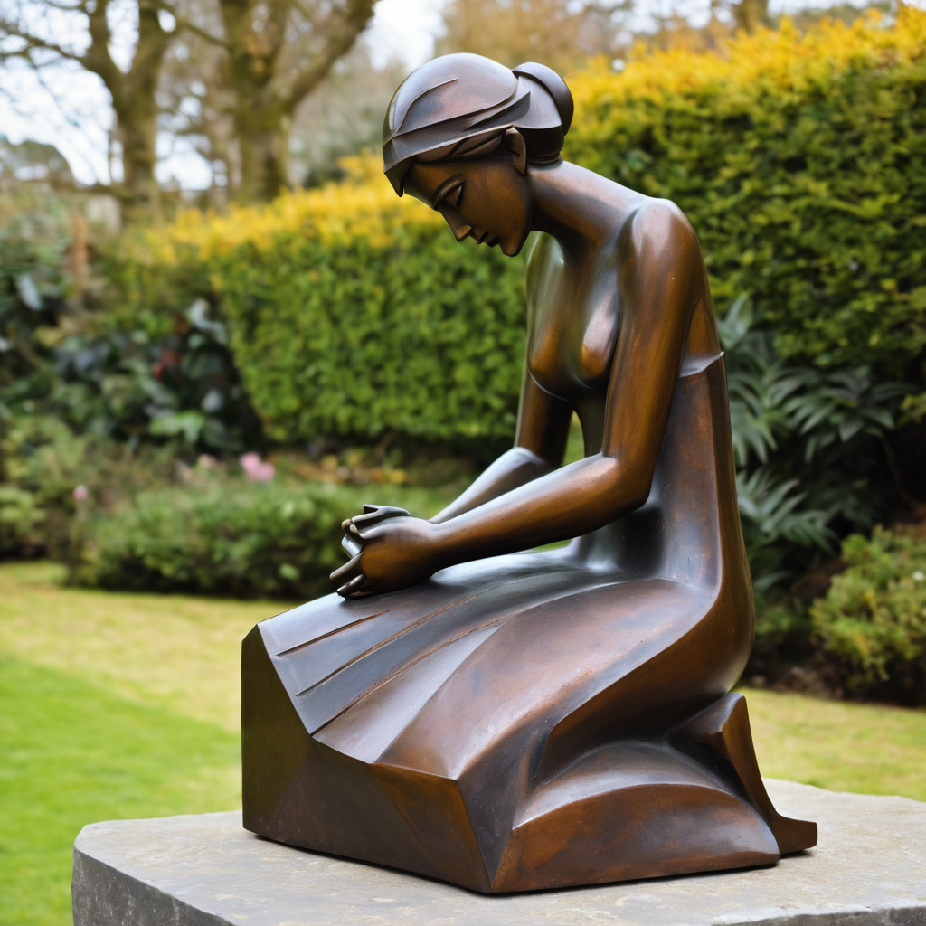
​
Leader: ​As we enter a few minutes of silence together, you are invited to pray the prayer of adoration on the next slide and/or spend this time in contemplation. ​
The Spiritual Communion prayer follows on the slide after that.
Let us be still.
Leader and Cantor Mute.
Continue…

Slide 51
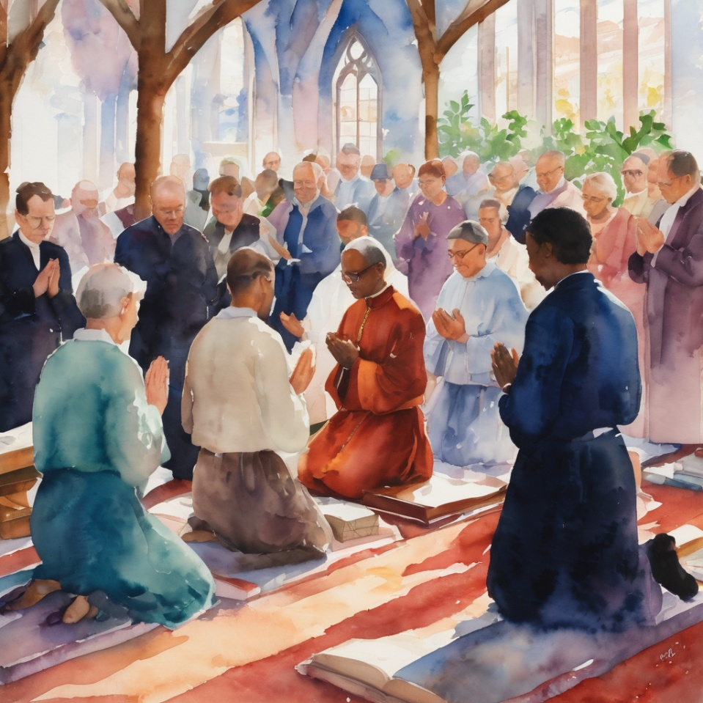
Lord, help us to be ready in all the steps we take.
Keep us strong and prepared as we step forward.
Pick us up and encourage us when we are tired.
Guide us when we think we have lost our way.
Bless all of our steps. Amen.
​
Notes:
Prayer for all ages from Roots

Slide 52

  Oh, my Lord Jesus I turn to you present at the Altar and in the Tabernacle. I believe that you are present in the Holy Sacrament of your most Sacred Body and Blood. I love you above all things and I desire to receive you into my Soul. I cannot at this moment receive you Sacramentally in Holy Communion. Come spiritually into my heart. Purify it, Sanctify it. Render my heart like your own heart. I embrace you as if you were already there and unite myself wholly with you. Never permit me to be separated from you. Lord, I am not worthy to receive you, but only say the word and I shall be healed. Amen
Making a Spiritual Communion
(Prayed in silence)
Notes:
Spiritual Communion Slide – Please do not change the prayer
Can change colour of background and title to match liturgical colour. You may also like to change the picture.

Slide 53
Leader unmutes
Our final song is
Love One Another
https://www.youtube.com/watch?v=DzP2xprUeAQ
We stay on mute
Leader mutes

Slide 54
Leader and cantor unmute
Sending Prayer
Leader: We pray our sending prayer together.
All: Lord, continue to guide our footsteps,
as we take things step by step to reach our goals,
knowing that you go with us,
our ever-present guide and enabler.
Wherever our footsteps take us, may your will be done.
Amen.
Notes:
Use Sending Prayer from Roots

Slide 55
The Benediction
Leader: Let us all invite God’s blessings together,
All: May the Lord bless us and keep us.
May the Lord’s face shine upon us and be gracious to us.
May the Lord’s countenance be lifted upon us,
and bring us peace.
Amen

Slide 56
Notices
Study Group Wednesday @ 6pm. We will be exploring a contemplative prayer series featuring seven poetic blessings written by Christine Valters. All are welcome to attend.
This Sunday Contemplative Services workshop @ 11am
See HHO Events page for further upcoming events HHO Events
Notes:
Up coming events can be added from the HHO event page/calendar

Slide 57
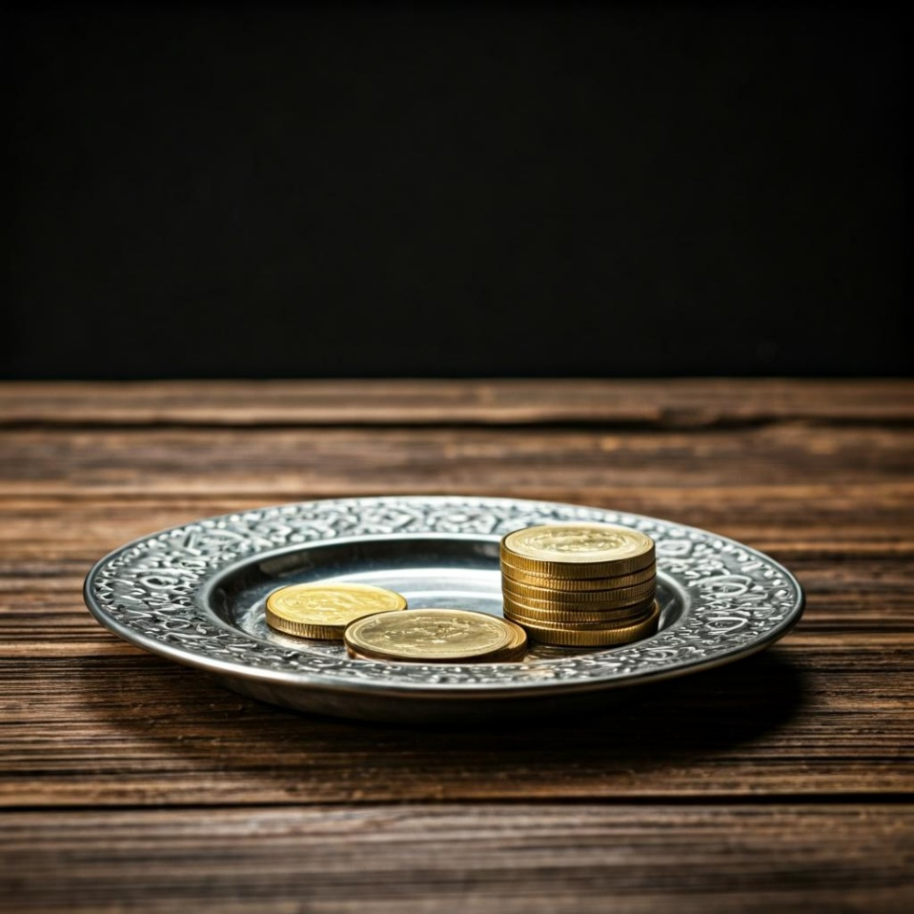
Leader: Thank you for your regular gifts to this ministry. Offerings are most welcome via:
The HHO App
Direct Debit
International Direct Debit
Please consider a one-off donation
or leaving a legacy in your Will
For further information go to HHO give page https://holyhermits.com.au/give

Slide 58
Serving next week
6 September 2026
15th Sunday after Pentecost
9:00 am AEST
Service Prep: Lauren | Chat Host: Viki | Fellowship: Julie
Music: Lauren | Welcomer: Julie | Safety Officer: Chris
Proof-reader: Chris | Leader: Julie | Attendance: Viki
Broadcaster: Lauren | Cantor: Kieron | Preacher: Lauren
Backup Broadcaster: Barry | First Reader: Viki | Deacon: Lauren
Zoom Buttons: Viki | Second Reader: Vanessa | Priest: N/A
Thank you for your ministry gifts
New Servers always welcome!
Please email Rev’d Lauren to get involved
holyhermits@anglicanchurchsq.org.au

Slide 59
The Dismissal
Leader: I invite everyone to unmute for the Dismissal
Leader: Go in peace to love and serve the Lord.
All: In the name of Christ, Amen.

Slide 60
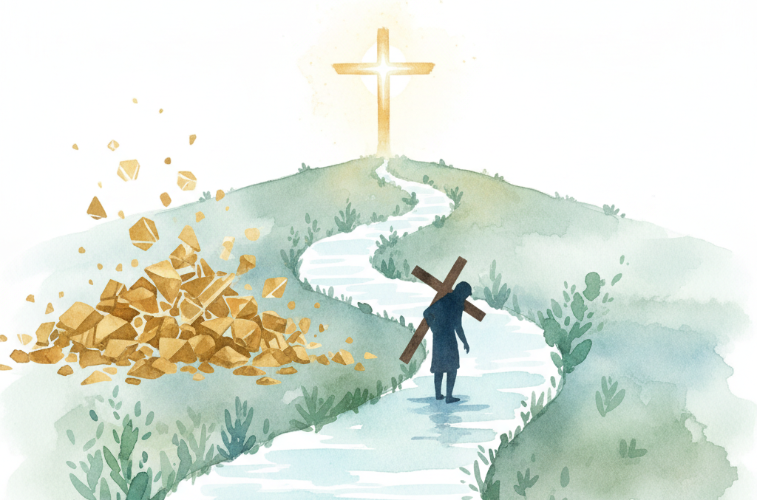
Fellowship
Thank you, Lauren for leading Fellowship
Please feel welcome to linger or pop a message in the chat and head off when you are ready.​
Extra resources developed
by Roots on the Web
Images from Padlet
Notes:
Please ensure high level of contrast for the fellowship text block to make it easier for people to read

